Slide 1
TODO LIST DApp
Presented by: Karthik Amaravadi
Sai Santosh Gedela

Slide 2
Contents
Overview
Architecture
Process Flow
Screenshots
Future Improvements
Lessons Learned

Slide 3
Overview
Our project is a to-do list decentralized web application, where each user have their own to-do list.
Users cannot see others’ to-do lists.
Each to-do list is connected to respective user’s Ethereum account address.
In this app the user can add tasks to their to-do list, prioritize tasks, delete task from the list, and display their tasks.
Tasks are displayed for each user in a table
Each task have task name and priority tags.

Slide 4
Overview
The project involves HTML, JavaScript, and Solidity languages.
The contract is deployed in remix IDE in testnet server.
In our case the testnet is Rinkeby testnet network.
For the functions add task, prioritize task, and delete task, the user need to little Ethereum for gas.

Slide 5
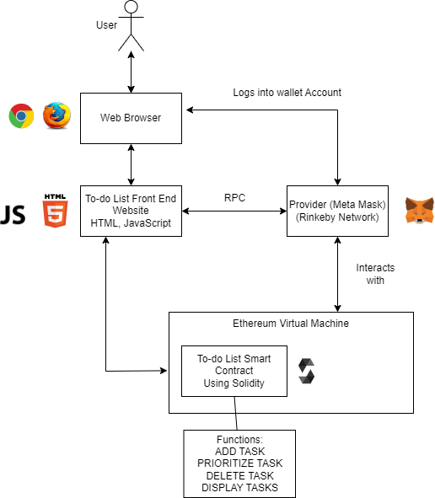
Architecture

Slide 6
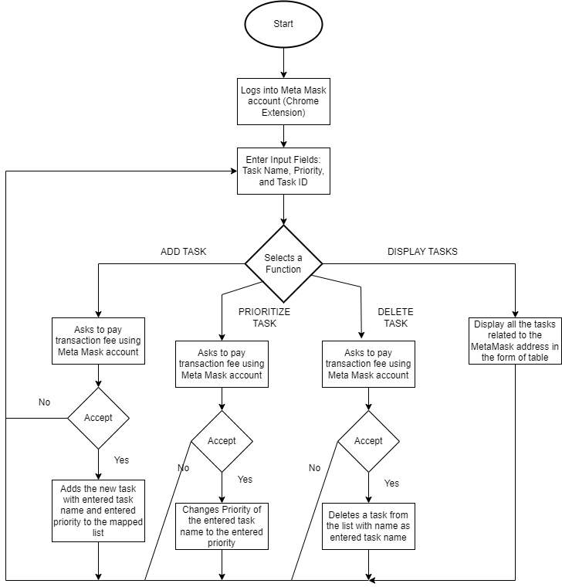
Process Flow

Slide 7
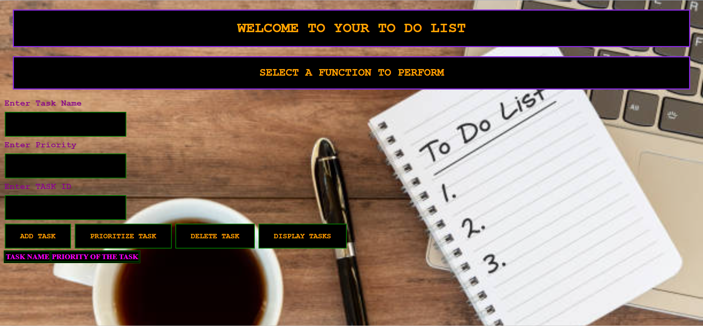
Screenshots
Front-End Web Page

Slide 8
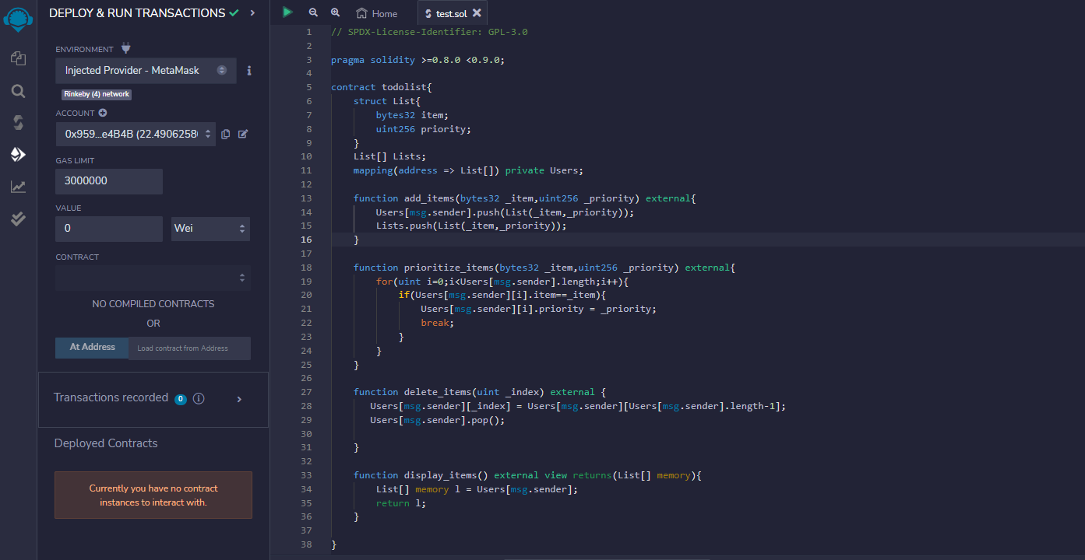
SCREENSHOTS
Back-End Code

Slide 9
Future improvements
We are thinking of adding due date attribute for each task and adding a calendar to keep track of tasks.
We will add another attribute for status of the task. The task will be flagged completed, yet to complete, or past due.
We will add a feature where, if a task due date is near there will be a remainder of the task as soon as the web page is opened.

Slide 10
Lessons Learned
Learned how a smart contract works more clearly.
Learned HTML, JavaScript and Solidity which we never worked with in the past.
To run a smart contract, it will require gas. More complex the code, it will cost more gas. So, writing efficient code is important.

Slide 11
THANK YOU

